Slide 1
Multivariate Statistics Mini-Project
Sainyukta Harichandra Gujar
PRN: 22060641026

Slide 2
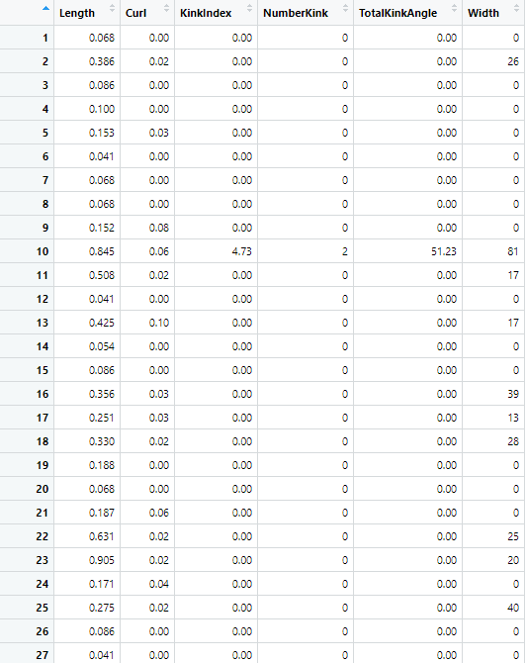
Dataset
A sample of aspen tree fibre as characterised by a fibre quality analyser.
Interested to know whether the total kink angle in wood fibre is affected by other factors like length, curl, width, etc. of wood bark.

Slide 3
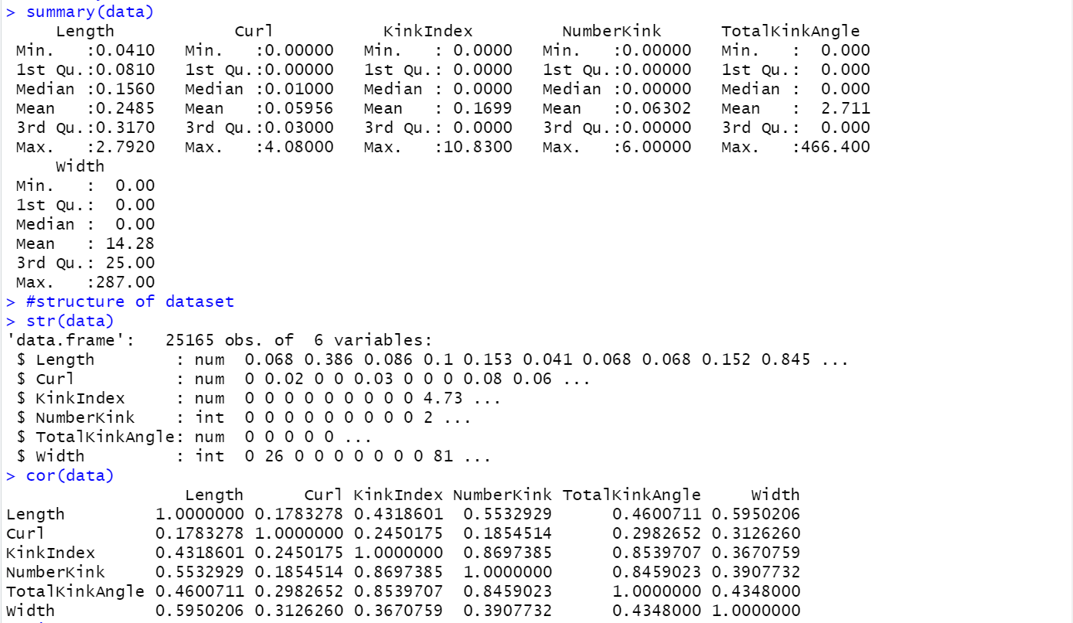
Descriptive Statistics
summary() gives us the Min, 1st Quartile, Median, Mean, 3rd Quartile and Max for all the numeric variables in data.
str() gives the structure of dataset and helps us in knowing the datatype of variables.
cor()gives us correlation between all the quantitative variables helping us to know the extent of correlation among variables.

Slide 4
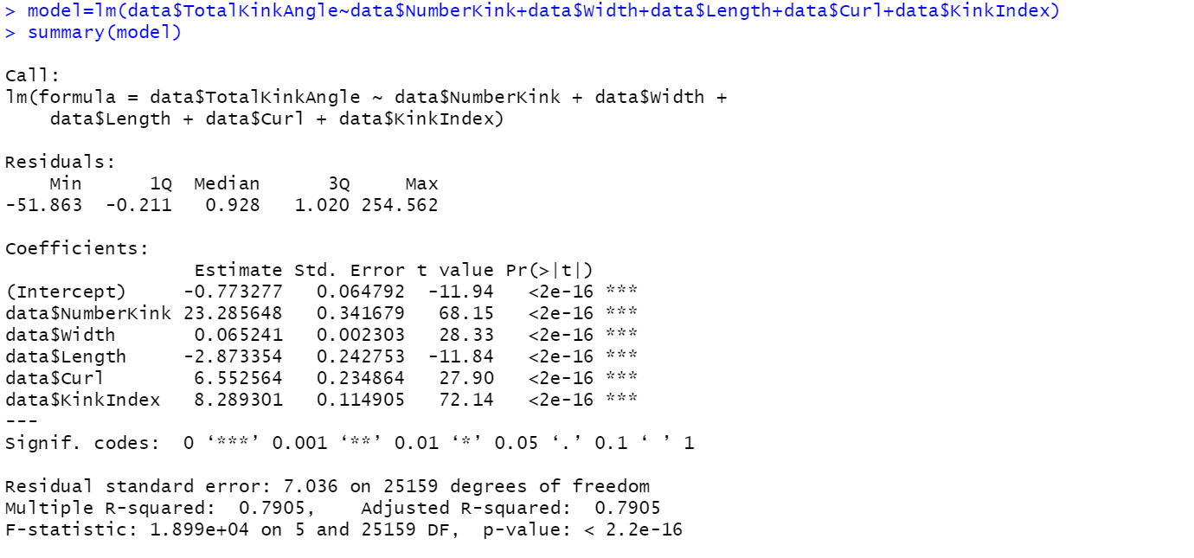
Fitting the Model
model=lm(y~x) fits a linear model where y acts as dependent variable and x acts as independent variable.
summary(model) gives us the value of adjusted R-square and the p-value which helps us in determining if the model is good fit for data.
Here, the value of adjusted R-square is 0.7905>0.5 which suggests the model is good fit for data. Also the p-value is <2.2e-16 which is <0.05 and hence data is significant.
The equation for fitting thus becomes TotalKinkAngle=-0.77+23.28*NimberKink+0.06*Width-2.87*Length+6.55*Curl+8.28*Kink Index

Slide 5
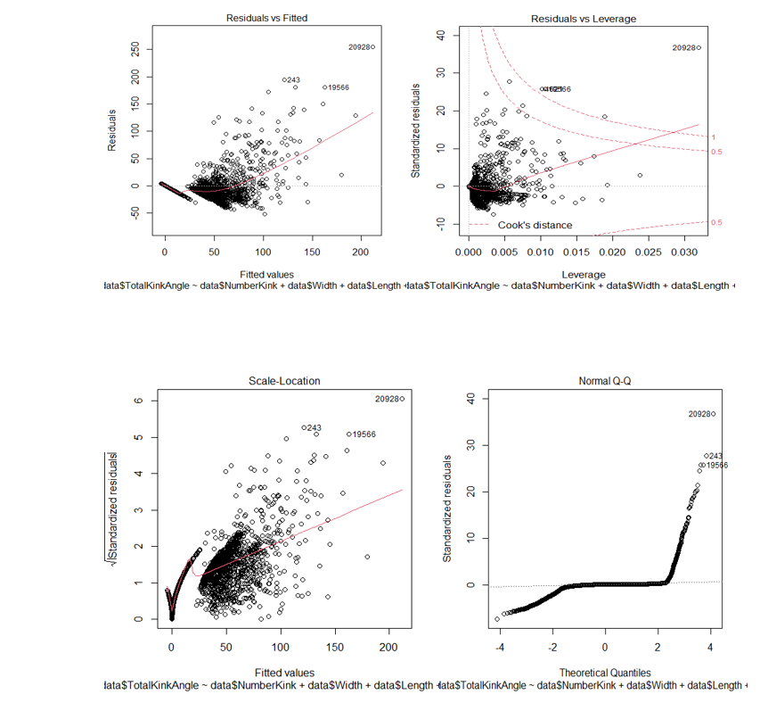
Plots
From the Residual vs Fitted graph we can conclude that we don’t have non linear relationship since we find equally spread residuals around horizontal line.
From Residual vs Leverage we tend to look for outliers at the upper right or lower right corners and here our data has some outliers.
From Scale-Location we check the assumption of equal variance(Homoscedasticity).Since we are unable to locate a horizontal line, homoscedasticity is present.
From Normal Q-Q plot we can conclude that the residuals are not normally distributed since the observations are deviating at the ends.

Slide 6
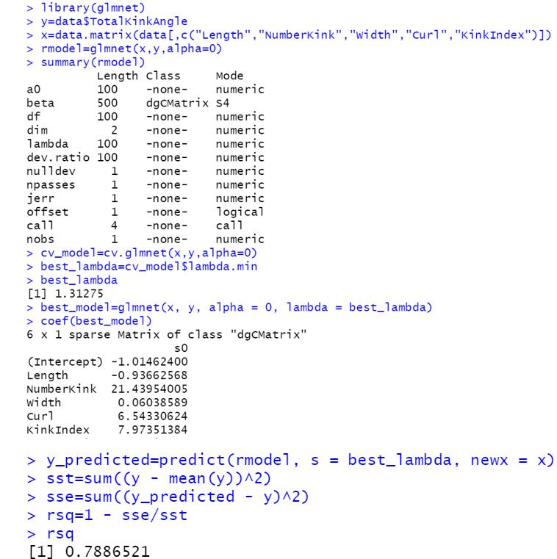
Ridge Regression
Since the variables Total Kink Angle, Number Kink and Kink Index are highly correlated(>0.8), multicollinearity is present in the data and hence we can go for ridge regression.
We use library glmnet() to perform ridge regression. Then depending of the lambda and alpha values we have fitted a new model with R-square value as 0.79.

Slide 7
THANK YOU

